Slide 1
BALAJI TEMPLE MATRIMONIAL SERVICES REGISTERED ASPIRANTS BRIDES

Slide 2
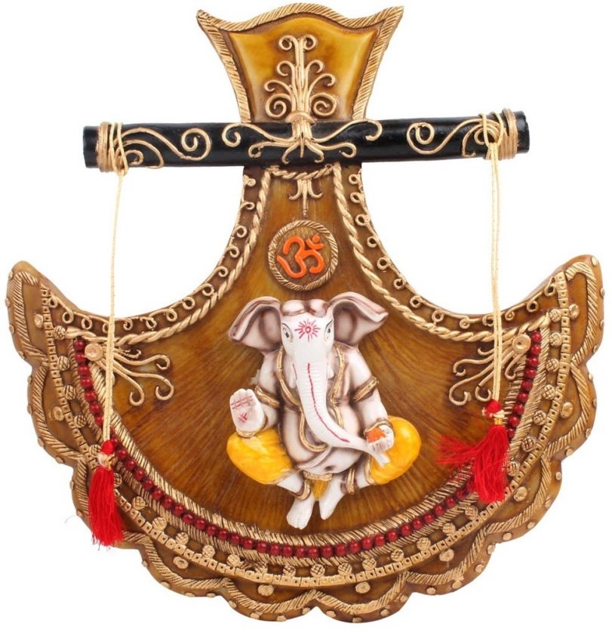
2024
01G24
Hindu Brahmin, British Citizen
D.O.B.: 01/05/1995 Height: 160CM
Qualification: MBBS, MPH
Currently working in NHS Glasgow
Hobbies: Reading, Walking, Music, Community work.
Looking for a respecting and valuing the people in my life (family and friends). Desire to support and facilitate each other’s personal and professional goals. Empathy and listening skills.
02G24
Hindu SC, Adi Dravida, French Citizen
D.O.B.: 14/08/1985 Height: 160CM
Qualification: M.Sc (Big Data Science)
Currently working as a Data Analyst.
Hobbies: Baking, Board Games, Dancing, Painting/Sketching/Drawing, Volunteer work.
Looking for a person who is well read, good looking, honest, witty, who respects people for what they are and their emotions. Aperson, who could be a good companion, matured and help each other in enjoying and balancing the life boat.

Slide 3
03G24
Hindu Brahmin, British Citizen, Divorced.
D.O.B.: 06/05/1986 Height: 5feet 3’’
Qualification: MSc. Engg.
Currently working as a Business Consultant.
Hobbies: Travelling, Gym, Enthusiast and Dancing.
Looking for a Uk based groom who is honest, empathetic and willing to be an equal life-partner. Prefer to have someone who is outgoing, easy to talk to, share similar interests and is physically active.
Cast is no bar but vegetarian and non-smoker is preferred. Expect the guy to understand Indian culture/tradition, respect for family and elders.
04G24
Hindu Arya Vysya, British Citizen.
D.O.B.: 28/10/1995 Height: 4feet 9’’
Qualification:BA Hons (UK).
Currently working as a Payroll Professional.
Hobbies: Badminton, Gym, Reading, Music, Watching TV/ Films and Travelling.
Looking for a suitable groom with a professional background who has been brought up in western culture and has moderate values. Non Smoker, Vegetarian/Eggetarian. Already settled in UK or interested in settling in the UK.

Slide 4
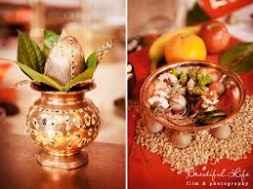
05G24
Hindu Marwari, British Citizen.
D.O.B.: 31/07/1995 Height: 5feet 6’’
Qualification: Master in Software Engg.
Currently working as a Consultant at Infor Ltd.
Hobbies: Reading, Photography, Puzzles.
Looking for a Groom.
06G24
Hindu Iyengar, British Citizen.
D.O.B.: 06/12/1995.
Qualification: Bbc (Hons).
Currently working as a Senior Publicist.
Looking for a UK Citizen, Vegetarian.
07G24
Hindu, Mudaliar, Indian Citizen
D.O.B.: 18/06/1997 Height: 5feet 4’’
Qualification: MBBS
Currently working as a Junior Doctor.
Hobbies: Melophile, Ardent reader, Traveller.
Looking for a spiritual, like minded person, who is supportive in my career like my father.

Slide 5
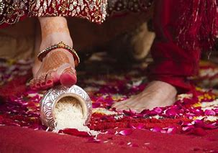
08G24
Hindu, Reddy, Indian Citizen
D.O.B.: 14/10/1994 Height: 5feet 3’’ Divorced
Qualification: B Tech
Currently working as a senior software engineer.
Hobbies: Music, Cooking, Pencil Sketching.
Looking for Indian Citizen belonging to Telugu/Reddy Community. Who is caring and have moral values and values marriage system.
09G24
Hindu, Kshatriya
D.O.B.: 31/08/1989 Height: 5feet 5’’ Divorced
Qualification: Msc
Currently working part time.
Hobbies: Travelling, Cooking, Painting.
10G24
Hindu, Brahmin, British Citizen
D.O.B.: 12/02/1998 Height: 5feet 5’’
Qualification: MBBS, BSc (Hons)
Currently working as a Doctor.
Hobbies: Reading, Travelling, Photography.
Looking for a Successful, Intelligent, Well Educated, Fun Loving, Extravert guy with strong values.

Slide 6
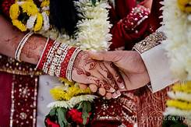
11G24
Hindu, Kapu, British Citizen
D.O.B.: 26/06/1998 Height: 5feet 8’’
Qualification: MSc, BSc
Currently working as a Natural England.
Hobbies: very social, spending time with family & friends, travelling, yoga and meditation.
Looking for a compatible partner who is settled in UK, preferably a doctor or engineer by profession and who respects Indian family values.
12G24
Hindu, Brahmin
D.O.B.: 00/08/1983 Height: 5feet 4’’ Divorced
Qualification: Bachelors in Engineering
Currently working as a Software Professional.
Hobbies: Swimming, Walking.
Looking for a well educated working professional, should be a vegetarian.
13G24
Hindu, Naicker, Indian Citizen
D.O.B.: 25/09/1988 Height: 5feet
Qualification: Bachelor in Engineering
Currently working as a Software Engineer.
Hobbies: Yoga, Travel and Nature.
Looking for a suitable loving and caring life partner to lead a meaningful life, planning to settle in UK as Bride having a general visa.

Slide 7
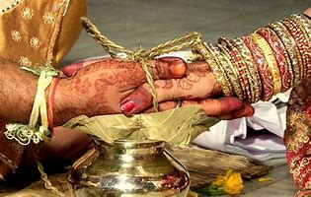
14G24
Hindu, Rajput, Indian Citizen
D.O.B.: 08/04/1987 Height: 5feet 5’’
Qualification: BTech(Hons), PGDM
Currently working as a Assistant Administrative Officer.
Hobbies: Dancing, Reading Books, Listening to Music, Travelling and Cooking.
Looking for a matrimonial match who is tall, well qualified, understanding and mature.
15G24
Hindu, Pillaj, Indian Citizen
D.O.B.: 12/02/1993 Height: 5feet 7’’ Divorced
Qualification: BE., MS
Currently working as a Logistics Admin.
Hobbies: Playing Table Tennis, Travelling to different Countries.
Looking for a family oriented groom, teetotaller, respect elders and who is supportive.
16G24
Hindu, Ezhava, Indian Citizen
D.O.B.: 26/02/1997 Height: 160CMS
Qualification: BSc (Hons) Nursing
Currently working as a Registered Nurse.
Hobbies: Reading, Listening Music, Watching Movies, Travelling.
Looking for an open minded traditional boy from Kerala who has a good professional career preferably medical background, who at some point intrested to migrate to the US, family oriented, loyal, ambitious, supportive partner, who is a teetotaler as well.

Slide 8
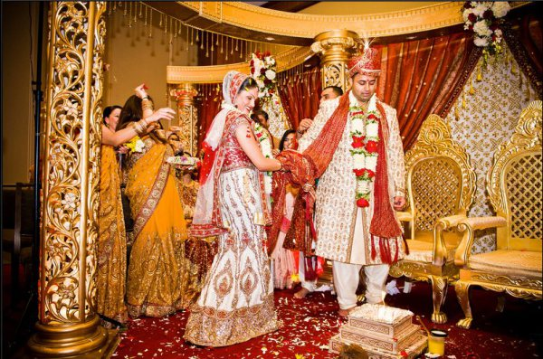
17G24
Hindu, Padmashali, Indian Citizen
D.O.B.: 09/09/1994 Height: 5feet 1’’
Qualification: Pursuing MS
Currently is a Student.
Hobbies: Cooking, Like to explore different places, Watching TV.
Looking for a pleasant family oriented groom (same caste and Telugu origin), well-educated, friendly, honest, Indian family values, respects women social, understanding nature, sharing thoughts, supportive, with family settled in UK or Groom working and want to settle in UK, preferably working in VLSI or IT field in UK.
18G24
Hindu, Bhraman, Indian Citizen
D.O.B.: 05/03/1987 Height: 5feet 4’’
Qualification: MSc in Artificial Intelligence
Currently working as a Project Manager.
Hobbies: Exploring new places, Reading.
Looking for a spiritual, optimistic, self-dependant and good sense of humor.

Slide 9
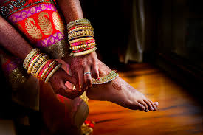
19G24
Naicker
D.O.B.: 10/06/1987
Qualification: PhD, MSc, MBA
Currently working as a Research Consultant at multinational company.
Hobbies: Going Outdoors, Watching Films, Sightseeing, Museums, Dancing.
Looking for a man who is self-confident and has an understanding of the importance of compromise in a relationship. Also a man who values my professional aspirations and is professionally driven himself.

Slide 10
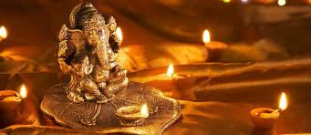
2023
01G23
Hindu Gaundar, British Citizen
D.O.B.: 10/11/1993 Height: 5feet 2’’
Qualification: MBChB Medicine
Currently working as a trainee GP Doctor
Hobbies: Reading, Writing, Watching TV Dramas.
Looking for a progressive Indian Groom in the Medical field.
02G23
Hindu Arora, Indian Citizen
D.O.B.: 09/08/1985 Height: 5feet 2’’
Qualification: B.COM
Currently working as a Banker
Hobbies: Travelling, Music.
Looking for a family oriented, simple man.

Slide 11
03G23
No Longer Available
04G23
Hindu Punjabi Arora, Indian Citizen
D.O.B.: 17/12/1986 Height: 5feet 2’’
Qualification: Student (Masters)
Divorced
Currently working in Teaching
Hobbies: Yoga, Watching Bollywood Movies, Meditation.
05G23
Hindu Vaani Chettiar, British Citizen
D.O.B.: 21/11/1995 Height: 151CM
Qualification: MBBS, Cambridge, UK
Currently working as Foundation Doctor
Hobbies: Very social, spending time with family, friends, travelling, singing.
Looking for a pleasant, family oriented groom, friendly, honest, Indian family values, respects women social, currently living in UK or is willing to settle down in UK!

Slide 12
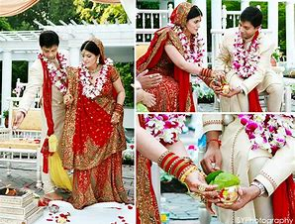
06G23
Hindu Jain, British Citizen
D.O.B.: 25/11/1994 Height: 5feet 9’’
Qualification: BE Chemical Engineering
Currently working as Risk Analyst
Hobbies: Cooking, Reading, Hiking, Travelling, Gym and Sports.
Looking for Compatible Partner
07G23
Hindu Brahmins, Indian Citizen
D.O.B.: 29/11/1989 Height: 5feet 3’’
Qualification: MBBS Doctor
Divorced
Currently working as a Junior Doctor in Medicine
Hobbies: Art, Cooking, Dancing, Pet Animals, Gardening.
Looking for Groom/Boy who is settled in UK and Doctor or Engineer as Profession.
08G23
Hindu Pillai, American Citizen
D.O.B.: 20/09/1993 Height: 5feet 2’’
Qualification: BSC Economics
Currently working Audit at KPMG, London
Hobbies: Listening to music, attending concerts, watching movies, playing piano, ballet & tap dancing, love to travel and explore different countries and their cultures.
Looking for a highly qualified post-graduate professional preferably in Medicine, Law, Dentistry, Banking, Accountancy or Senior Manager IT.

Slide 13
09G23
Hindu Kapu, Indian Citizen
D.O.B.: 29/05/1993 Height: 5feet 5’’
Qualification: Masters in Data Science and Analytics
Currently is a Student
Hobbies: Travelling, Painting.
Looking for a good looking, Understanding.
10G23
Hindu Brahmin, Indian Citizen
D.O.B.: 16/07/1999 Height: 5feet 6’’
Qualification: B.Tech (EEE)
Currently is working as a Software Engineer
Hobbies: Watching Movies, Travelling and Music.
Looking for a good looking groom born after 1995 & strictly vegetarian. Setelled in India, UK, Europe or USA.
11G23
Hindu Mudaliar, British Citizen
D.O.B.: 18/06/1997 Height: 155CM
Qualification: MBBS
Currently is working in NHS
Hobbies: Reading, Nature, Games, Music, Cooking.
Looking for a groom from Medical background, well educated, family orientated, friendly and outgoing.

Slide 14
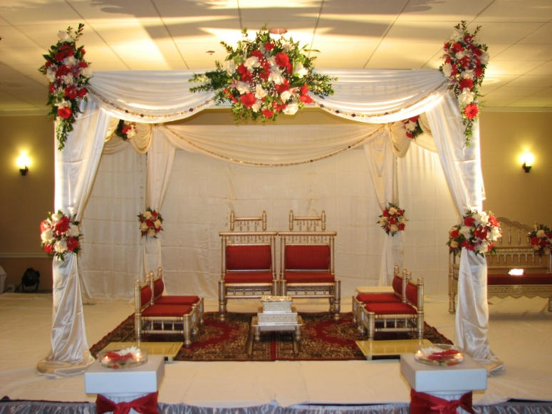
12G23
Hindu Gohal, Indian Citizen
D.O.B.: 21/01/1993 Height: 5feet 4’’
Qualification: Masters in English Linguistics & Commerce
Currently is working as a Teacher
Hobbies: Reading Books, Dance, Travel.
Looking for a boy who is educated, well settled, religious and down to earth.
13G23
Hindu Naidu, Indian Citizen
D.O.B.: 17/09/1996 Height: 5feet 8’’
Qualification: MBBS
Currently is working as a Junior Doctor
Looking for Telugu/Tamil Doctor Groom working in the UK.
14G23
Hindu Brahmin, Indian Citizen
D.O.B.: 05/05/1989 Height: 5feet 5’’
Qualification: MBBS, MD, MSc
Currently is working as a Global Patient Safety Physician, Ipsen Pharma Ltd
Hobbies: Table Tennis, Swimming, Music, Cooking.
Looking for a non-smoker, preferably willing to settle in UK.

Slide 15
15G23
Hindu Brahmin, British Citizen
D.O.B.: 19/09/1994 Height: 5feet 5’’
Qualification: ICAEW Chartered Accountant, BSC Computer Science
Currently is working as a Technology Risk Consultant
Hobbies: Music, Travelling, Cooking, Watching TV Shows.
Looking for a vegetarian Bramin boy from a decent family background who is friendly, caring and with a good sense of humor. Preferably in and around London.
16G23
Hindu Balija
D.O.B.: 21/06/1983 Height: 5feet 6’’
Qualification: Graduate
Currently is working as a Primary School Teacher
Hobbies: Going for walks in nature, Keeping fit, Listening to Music, Dance, Reading and Travelling.
Looking for a kind, understanding and loyal to be a long term partner that leads to marriage.
17G23
Hindu Kayasth, British Citizen
D.O.B.: 25/06/1997 Height: 155 CM
Qualification: Masters in Optometry
Currently is working as an Optometrist
Looking for Professional based in UK.

Slide 16
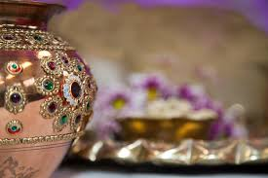
18G23
Hindu Khatri, British Citizen
D.O.B.: 14/08/1981 Height: 5feet 3’’ Divorced
Qualification: M.Pharmacy
Currently is working as a Pharmacist.
Hobbies: Gym, Cooking, Writing.
Looking for a kind, family and commitment orientated, similar values, preferably vegetarian and born in UK.
19G23
Hindu Baniya, Indian Citizen
D.O.B.: 07/12/1994 Height: 5feet 4’’
Qualification: MBBS
Currently working with NHS.
Hobbies: Travelling, Reading.
Looking for a suitable match with similar background.
20G23
Hindu Sonar, British Citizen
D.O.B.: 18/06/1988 Height: 5feet 7’’
Qualification: BSc Computer Science
Currently is working as an IT Software Engineer.
Hobbies: Gym, Spending time with family.
Looking for a clean shave, tall boy who is genuine and looking for serious relationship only.

Slide 17
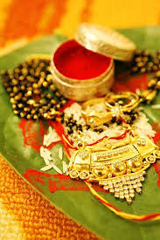
21G23
Hindu Veerashiva Lingyath, British Citizen
D.O.B.: 24/07/1996 Height: 5feet
Qualification: MBBS, BSc
Currently is working as a Doctor.
Hobbies: Country side and forest walks, Travel, Muesums.
Looking for a kannadigas raised in UK aged 26-32, vegetarian, non-smoking and devoted individuals.
22G23
Hindu, British Citizen
D.O.B.: 18/09/1997 Height: 5feet 7’’
Qualification: MBBS
Currently working as a Doctor
Hobbies: Sports, Photography, Reading, Travelling.
Looking for a like minded individual who wants to build a family together.
23G23
Hindu Rai and Kshatriya, British Citizen
D.O.B.: 17/07/1997 Height: 5feet 5’’
Qualification: BSc Biomedical Science, MSc Biomedical Engineering
Currently is studing Coding.
Hobbies: Reading, Travelling, Cooking, Drawing and Painting.
Looking for a hindu groom who is also a British citizen or Indian Citizen working already in UK. Ideally 5ft.5’’ and above to 6ft height. Family oriented person who is respectful in every manner of life. Cast no bar, ideally considered from any Hindu and South Indian language speaking family.

Slide 18
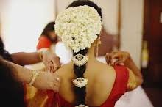
24G23
Hindu chettiar, Indian Citizen
D.O.B.: 07/05/1986 Height: 5feet 4’’
Qualification: B.Tech.
Currently working in IT - Product Delivery.
Hobbies: Swimming, Craft, Travelling and Painting.
Looking for a professiona, good companion, friendly person, non smoker, family oriented person.
25G23
Hindu Visvakarma, British Citizen
D.O.B.: 24/08/1998 Height: 5feet 3’’
Qualification: MBBS.
Currently working as a Junior Doctor
Hobbies: Swimming, Travelling.
Looking for a bridegroom with professional background, employed and settled in UK.
26G23
Hindu Vellalar, Indian Citizen
D.O.B.: 28/12/1993 Height: 165 CM
Qualification: B.Tech, HRLP.
Currently working in Goldman Sachs – Associate.
Hobbies: Science fiction books, Movies, Writing, Cooking, Yoga.
Looking for a qualified, professional, kind, supportive partner.

Slide 19
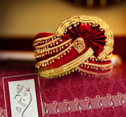
27G23
Hindu, British Citizen
D.O.B.: 13/03/1995 Height: 4feet 11’’
Qualification: ACCA.
Currently working as a Senior Management Accountant.
Hobbies: Bharathanatyam, Travelling, Reading, Gaming.
Looking for a non vegetarian, british citizen, someone who likes to travel, lives in London, good profession, family-orientated, south indian.
28G23
Indian Citizen
D.O.B.: 22/09/1988 Height: 5feet 3’’
Qualification: B.E, M.S.
Currently working as a Senior Electrical Engineer.
Hobbies: Travelling, Trekking, Adventurous Sports, Reading Etc.
Looking for somebody willing to travel and explore.
29G23
Hindu Gujarati, British Citizen
D.O.B.: 11/02/1980 Height: 5feet 2’’
Qualification: Degree.
Hobbies: Eating out, Going out for Tea/Coffee/Water/Juice, Food, Cinema, Walking, Swimming, Listening to Music, Dancing, Like to visit different places and Resting.
Looking for a good person/qualities, mostly similar interests and affluent knows they want to get married to me and not taking a long time to get married to me.

Slide 20
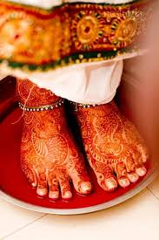
30G23
Hindu Tamil Iyer, Indian Citizen
D.O.B.: 01/05/1985 Height: 5feet 2’’
Qualification: LLB Honors.
Currently working as a Principle Assosiate.
Hobbies: Watching Sports, Comedy Shows, Bollywood Films.
Looking for a well educated person and good family.
31G23
Hindu Kallar, British Citizen
D.O.B.: 07/04/1988 Height: 5feet 4’’
Qualification: MBChB (Doctor).
Currently working in NHS
Hobbies: Music, Singing & Dancing.
32G23
Hindu Arya Vysya, British Citizen
D.O.B.: 28/10/1995 Height: 4feet 9’’
Qualification: BA Hons.
Currently working as Payroll Professional
Hobbies: Badminton, Gym, Reading, Music, Watching TV/Films and Travelling.
Looking for a suitable groom with a professional background who has been brought up in a western culture and has moderate values. Non smoker, vegetarian/eggetarian. Already settled in UK or interested in settling in UK.

Slide 21
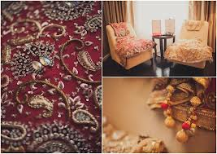
33G23
Hindu Padmashali, Indian Citizen
D.O.B.: 24/08/1997 Height: 5feet 3’’
Qualification: Masaters of Science.
Currently working as a Lab Assistant.

Slide 22
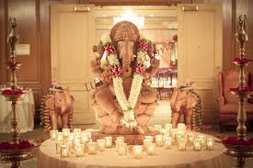
2022
01G22
Hindu Mudaliyar, Indian Citizen
D.O.B.: 04/03/1993 Height: 150CM
Qualification: BE., MS., PhD
Currently working as Clinical Researcher/Scientist at Policlinico Di Bari
Hobbies: Reading, Writing Potries, Travelling, Movies, Dance, Mehendi Designing, Walking, Yoga and Cooking.
Looking for a soulmate, who is down to Earth, Understanding, Enjoys every moment of Life and Be my best friend for rest of my Life.
02G22
Hindu Pillai, Indian Citizen
D.O.B.: 15/11/1997 Height: 170CM
Qualification: M.S(Masters Of Science)
Currently working in Embeded Systems
Hobbies: Reading Books, Listening to Music, Travelling.
Looking for Preferably Masters Degree and Above with Good Family Values.

Slide 23
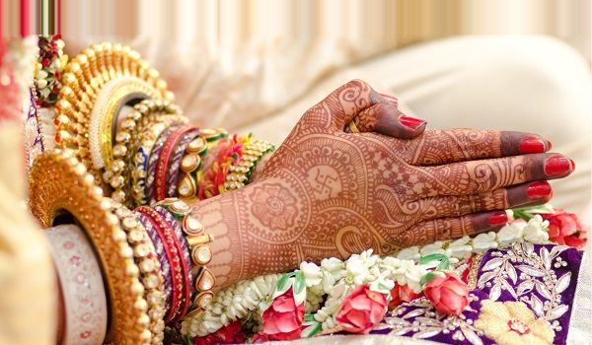
03G22
Hindu Kamma, Indian Citizen
D.O.B.: 09/06/1995 Height: 5feet 1’’
Qualification: Masters in UK
Currently working in Deloitte London
Hobbies: Music, Travelling, Dance and Literature.
Looking for Employed in Bank/ Software/ Audit/ Doctor.
04G22
Hindu, Indian Citizen (Divorced)
D.O.B.: 02/05/1992 Height: 5feet 6’’
Qualification: BTech
Currently working as Software Consultant
Hobbies: Reading, Travelling, Cooking.
Looking for a life partner who is family-oriented, committed and willing to support my carrer intrest. Should be a vegetarian and non smoker, preferably a non drinker. Must be living in UK currently.
05G22
Hindu, UK Citizen
D.O.B.: 10/11/1989 Height: 5feet 5’’
Qualification: BSC Business
Currently Self-employed
Hobbies: Singing, Yoga.
Looking for Bridegroom : Successful professional entrepreneur in Fintech, IT and banking. Someone open-minded, ambitious, confident with an affluent background, well settled.

Slide 24
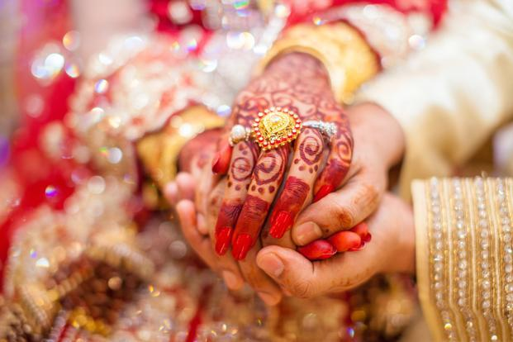
06G22
Hindu, Indian Citizen
D.O.B.: 28/03/1993 Height: 159cm
Qualification: MBBS, MRCGP, DRCOG General Practice
Currently GP Training
Looking for an understanding, respectable and well educated person. Preferably Telugu origin, willing to settle in the UK
07G22
Hindu Naidu, UK Citizen
D.O.B.: 17/07/1984 Height: 5feet 1’’
Qualification: MBA Supply Chain
Currently a Customer Success Manager
Hobbies: Yoga, Reading, Hiking.
Looking for Educated, well-mannered, established in career or business.
08G22
Hindu Vellalar/Pillai, Malaysian Citizen
D.O.B.: 16/05/1977 Height: 5feet 5’’
Qualification: Ba Accounting & Finance, Association Of Chartered Certified Accountant
Currently is a HOD at a Malaysian listed conglomerate
Hobbies: Walks, Hikes, Nature Activities, Yoga, Piano, Books, DIY, Cafes Hangouts, Travels.
Looking for Professional, Responsible & Adventurous Male.

Slide 25
09G22
No Longer Available
10G22
Hindu Pillai, British Citizen
D.O.B.: 13/06/1992 Height: 5feet 1’’
Qualification: MA Architecture
Currently is a Architectural Designer
Hobbies: Reading, Movies, Gym.
Looking for someone who is kind, caring, family-orientated and with good values.
11G22
No Longer Available
12G22
Hindu Brahmin, Indian Citizen
D.O.B.: 00/06/1996 Height: 156cm
Qualification: MBBS
Currently is a Resident in Emergency Medicine
Looking for vegetarian, non smoker, non drinker, caring and understanding, good character who values Indian culture, family and relationship, preferably Doctors, other professionals holding a post graduate degree.

Slide 26
13G22
Hindu Brahmin, British Citizen
D.O.B.: 22/09/1989 Height: 5feet 5’’
Qualification: MBBS FRCR
Currently is a Doctor at NHS
Hobbies: Badminton, Art & Travel.
Looking for professional settled in UK.
14G22
Hindu Pillai, Indian Citizen
D.O.B.: 14/11/1994 Height: 5feet 11’’
Qualification: MBBS
Currently is a Senior House Officer
Hobbies: Fiction (Books/Movies), Travel & Music.
Looking for a professional working towards a career in the United Kingdom.
15G22
British Citizen
D.O.B.: 12/02/1995 Height: 5feet 1’’
Currently is a Software Developer.

Slide 27
16G22
Hindu Reddy, British Citizen
D.O.B.: 23/03/1998 Height: 5feet 8.5’’
Qualification: BDS
Currently is a Associate Dentist
Hobbies: Indian Classical Dance, Photography.
Looking for a Dentist /Doctors only Please.

Slide 28
2021
01G21
Hindu Brahmin – Tamil & Telugu background, British Citizen
Dorn : October 1997, Height: 5’3.5’’ Mother Tongue : Telugu (knows Tamil)
Qualification: B.Sc. Maths & Actuarial Science, presently working as Graduate Actuarial Trainee.
Also undertaking exams & training to eventually qualify as a Fellow of the Institute of Actuaries (FIA).
Hobbies: Keeping-fit, Sports, Cooking, Listening-Music, Travel, Reading, Public-speaking, Entrepreneurship.
Prefers a professional qualified in any of : Actuary / CFA / ACA / ACCA /Data Science / IT Software / Engineering.
Looking for a Tamil (or) Telugu, Brahmin Vegetarian, life-partner, who is caring, family-oriented, committed, and willing to be supportive of my career interests and hobbies.
02G21
Hindu Muthurajah, British Citizen
D.O.B.: 06/02/1986 Height: 5feet 2’’
Qualification: ACMA (CIMA) and MSc
Currently working as Chartered Accountant (Head of Finance)
Hobbies: Youtube, Podcasts, Gardening, Yoga, Meditation, Music and Cooking.
Looking for Male aged 36-39 settled in UK. Must be Indian or Colombotamil working in a senior position like businessman, banker, dentist and likewise. Education slightly less than bride is ok. Background and chart match is key. Non smoker, non drinker and non vegetarian. Must be living in UK.

Slide 29
03G21
Hindu Sri-Vaishnavas, Indian Citizen
D.O.B.: 01/03/1996 Height: 5feet 4’’
Qualification: MCA (Computer Applications)
Currently Student
Hobbies: Cooking & Reading.
Looking for an unmarried bridegroom from Sri Vaishnava or Brahmin community/sub caste in well placed and remuneration with background of good character, good family with age below 30 years.
04G21
Hindu Vishwakarma, Indian Citizen
D.O.B.: 21/10/1996 Height: 5feet 7’’
Qualification: Bachelor of Engineering
Currently Student
Hobbies: Classical dance (Bharatnatyam), Yoga.
Looking for Suitable Groom with clean habits, family oriented person.

Slide 30
05G21
No Longer Available
06G21
Hindu Goud Saraswat, Indian Citizen
D.O.B.: 15/10/1996 Height: 5feet 6’’
Qualification: Bachelor in Cardio Vascular Technology
Currently Working as Specialist Cardiac Physiologist
Hobbies: Cooking, Swimming, Gym, Music.
Looking for Engineeror Doctor with height 5’7’’ or above, from GSB family, age gap of upto 5 years, willing to settle in Uk.
07G21
Hindu Bramin (Iyer), Indian Citizen
D.O.B.: 05/03/1992
Qualification: MS (I T)
Currently Working as Test Engineer
Looking for any Bhramin.

